Slide 1
CANDIDATE STEP BY STEP - VERIFYFAST

Slide 2

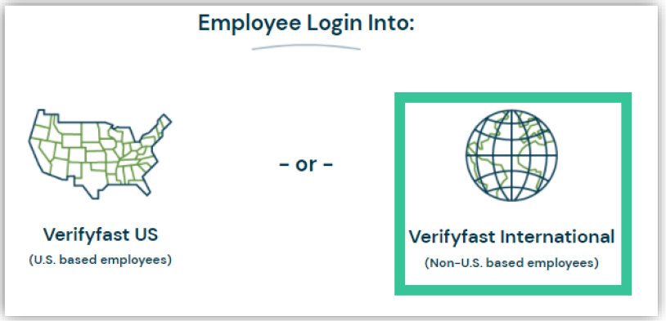
Set-up Verifyfast Account
STEP 1: Please visit www.verifyfast.com
STEP 2: Click LOGIN (Top right side)
STEP 3: Select EMPLOYEE
STEP 4: Select VERIFYFAST INTERNATIONAL

Slide 3
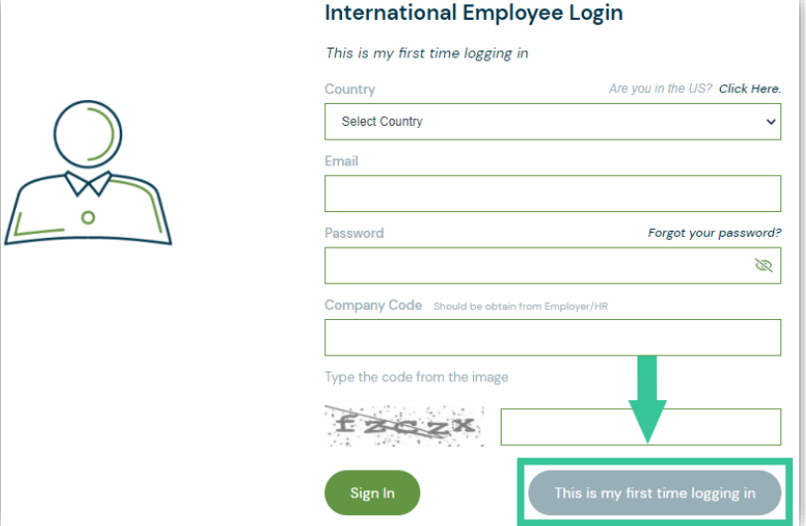
Set-up Verifyfast Account
STEP 5: Click THIS IS MY FIRST TIME LOGGING IN

Slide 4
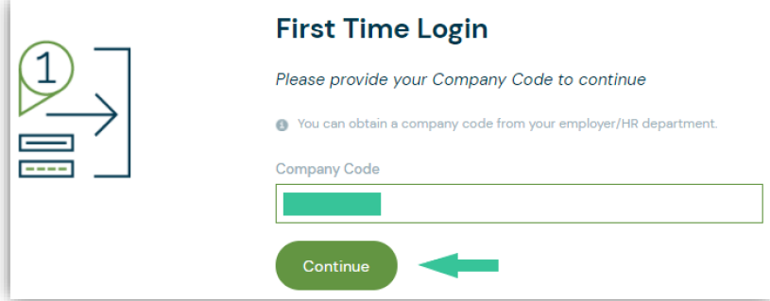
Set-up Verifyfast Account
STEP 6: Enter your COMPANY CODE (12456) , then click CONTINUE

Slide 5
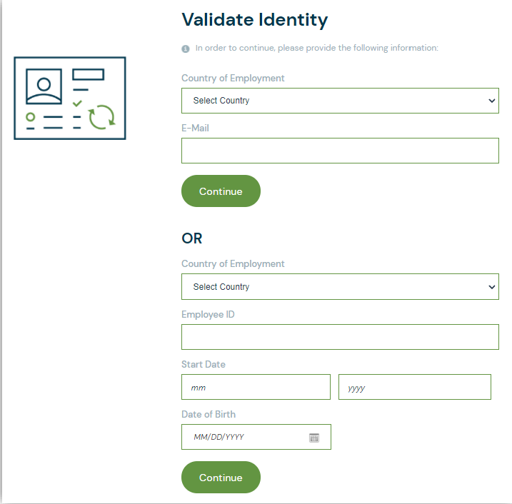
Set-up Verifyfast Account
STEP 7: Validate your Identity
Select second option available and enter the information requested, then click CONTINUE.
These options may vary depending on your employer/company settings.
STEP 8: UPDATE ACCOUNT
Enter your email as your username
and create a password

Slide 6

Approve Verifier’s Verification Request
STEP 1: Log in to your Verifyfast account
STEP 2: Select I HAVE A REQUEST CODE

Slide 7
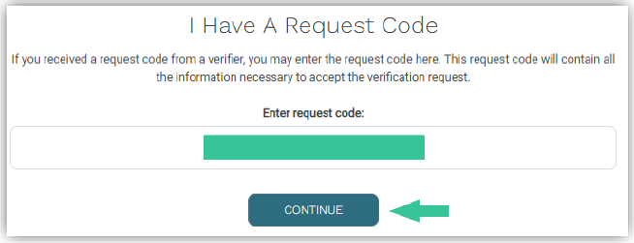
Approve Verifier’s Verification Request
STEP 3: Enter REQUEST CODE provided to you by the Fist Advantage(FA) on e-mail, then click CONTINUE

Slide 8
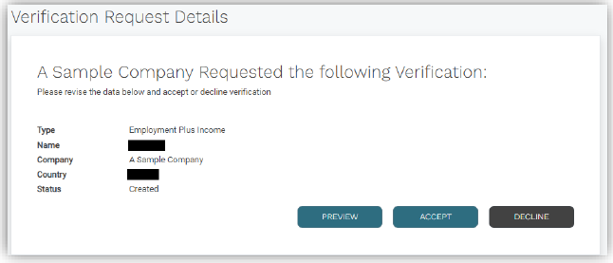
Approve Verifier’s Verification Request
STEP 4: Select PREVIEW, ACCEPT, or DECLINE
The verifier will be notified once you have made your selection

Slide 9
THANK YOU

